Slide 1


Syracuse University Master’s in Applied Data Science
Bryce Anthony
Applied Data Science Portfolio Overview

Slide 2
TABLE OF CONTENTS
01. About Me
03. Projects
04. Conclusion
-Education
-Work Experience
-Personal Goals
-Cloud Management
-Database Administration Concepts
and Database Management
-Introduction to Data Science
-Applied Machine Learning
-Text Mining
-Business Analytics
-Achievement
Across Learning
Objectives
-Key Takeaways
02. Learning Objectives
05. Thank You
ADS program learning objectives
Bryce Anthony
Applied Data Science Portfolio Overview
December 2024

Slide 3
01
ABOUT ME
Bryce Anthony
Applied Data Science Portfolio Overview
December 2024

Slide 4
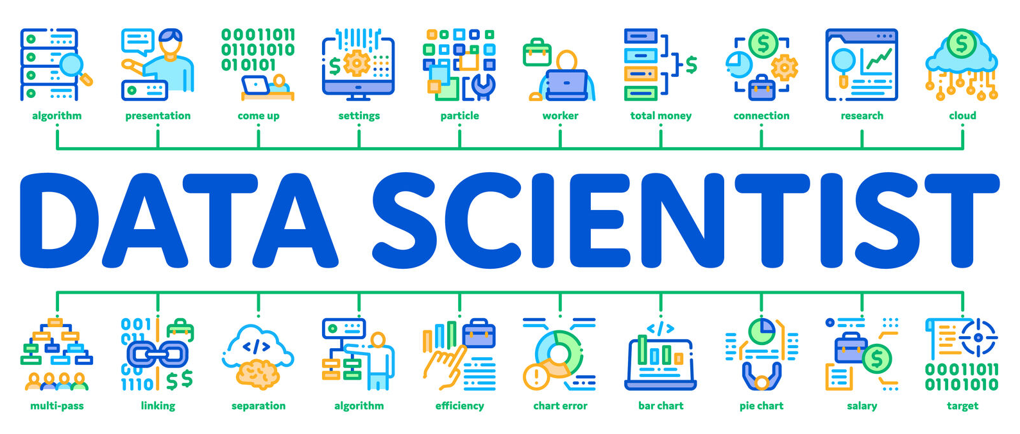


Bryce Anthony
ABOUT ME
Work Experience
Data science Co-op with Keurig Dr Pepper Research & Development
Software Engineering Consultant with the Jay Hurt Hub at Davidson College
Summer Institute in Biostatistics and Data Science Program at Boston University
Community Research Fellow with the Davidson College Center for Civic Engagement
Personal Goals
Bridge the Gap Between Society and AI Technologies
Apply Data Science to Real-World Challenges
Present research findings in a clear and accessible way to diverse audiences
Promote Ethical AI Practices.
Education
B.S. Computer Science from Davidson College (2019- 2023)
M.S. Applied Data Science from Syracuse University (2023- 2024)
Bryce Anthony
Applied Data Science Portfolio Overview
December 2024

Slide 5
02
LEARNING OBJECTIVES
Bryce Anthony
Applied Data Science Portfolio Overview
December 2024

Slide 6
Learning Objectives
Collect, store, and access data by identifying and leveraging applicable technologies
Create actionable insight across a range of contexts (e.g. societal, business, political), using data and the full data science life cycle
Apply visualization and predictive models to help generate actionable insight
Use programming languages such as R and Python to support the generation of actionable insight
Communicate insights gained via visualization and analytics to a broad range of audiences (including project sponsors and technical team leads)
Apply ethics in the development, use and evaluation of data and predictive models (e.g., fairness, bias, transparency, privacy)
Bryce Anthony
Applied Data Science Portfolio Overview
December 2024

Slide 7
03
PROJECTS
Bryce Anthony
Applied Data Science Portfolio Overview
December 2024

Slide 8
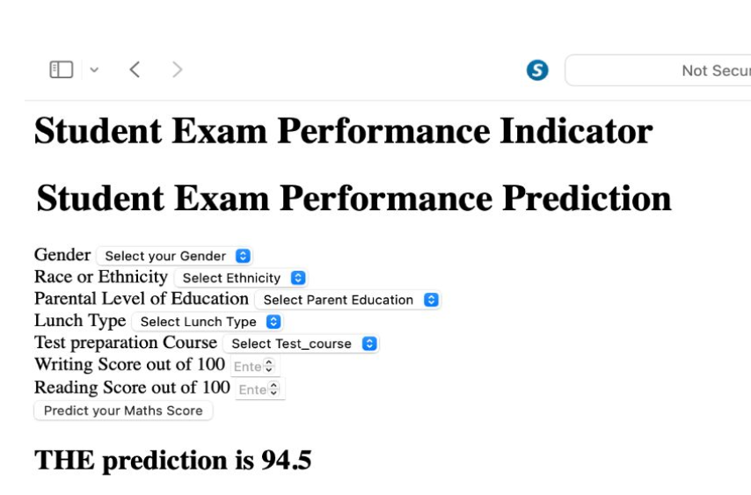
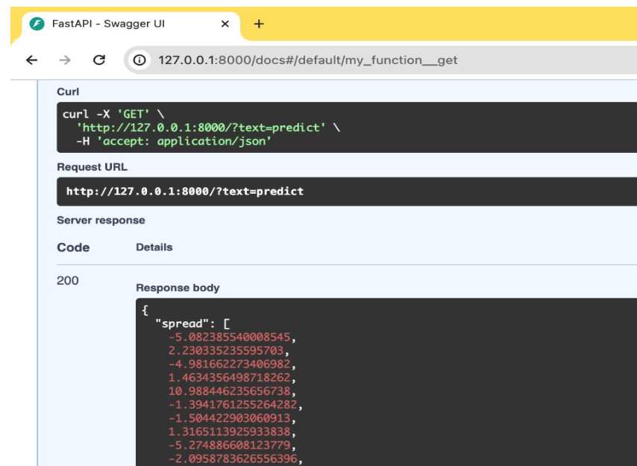
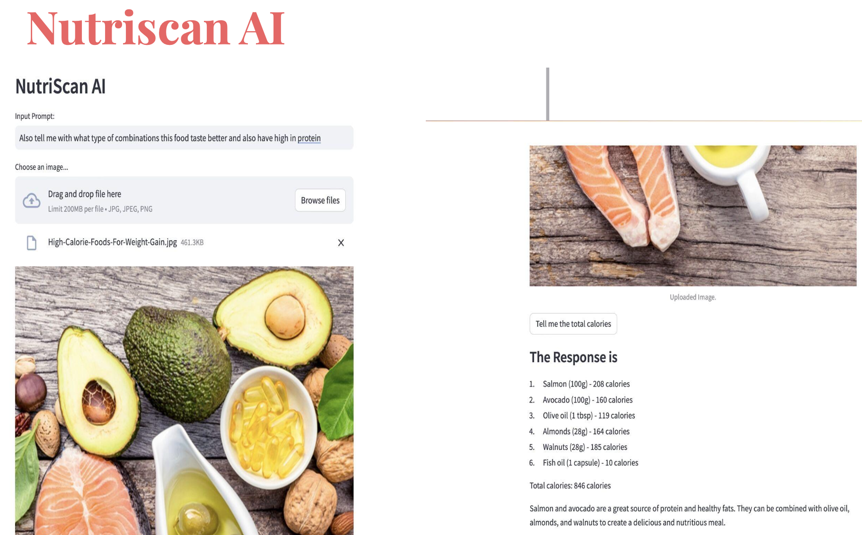
Deploying AI Solutions
Cloud Management (IST 615)
Three Artificial Intelligence solutions deployed:
An Exam Score Prediction model- Built using python and flask, uses demographic information and past exam scores to predict an exam score.
NBA Match Prediction model- Deep learning model using NBA stats to predict both the winner and the point differential between the two teams for regular season NBA games
NutriScan AI- A google gemini pro powered application delivering user prompted nutritional advice
Demonstrated Learning Outcomes :
Using programming languages and visualizations to provide actionable insights
Providing actionable insights across diverse contexts
The consideration of ethics in the data collection and resource usage
Projects
Objective:
Deploy artificial intelligence models in cloud environments
Bryce Anthony
Applied Data Science Portfolio Overview
December 2024

Slide 9
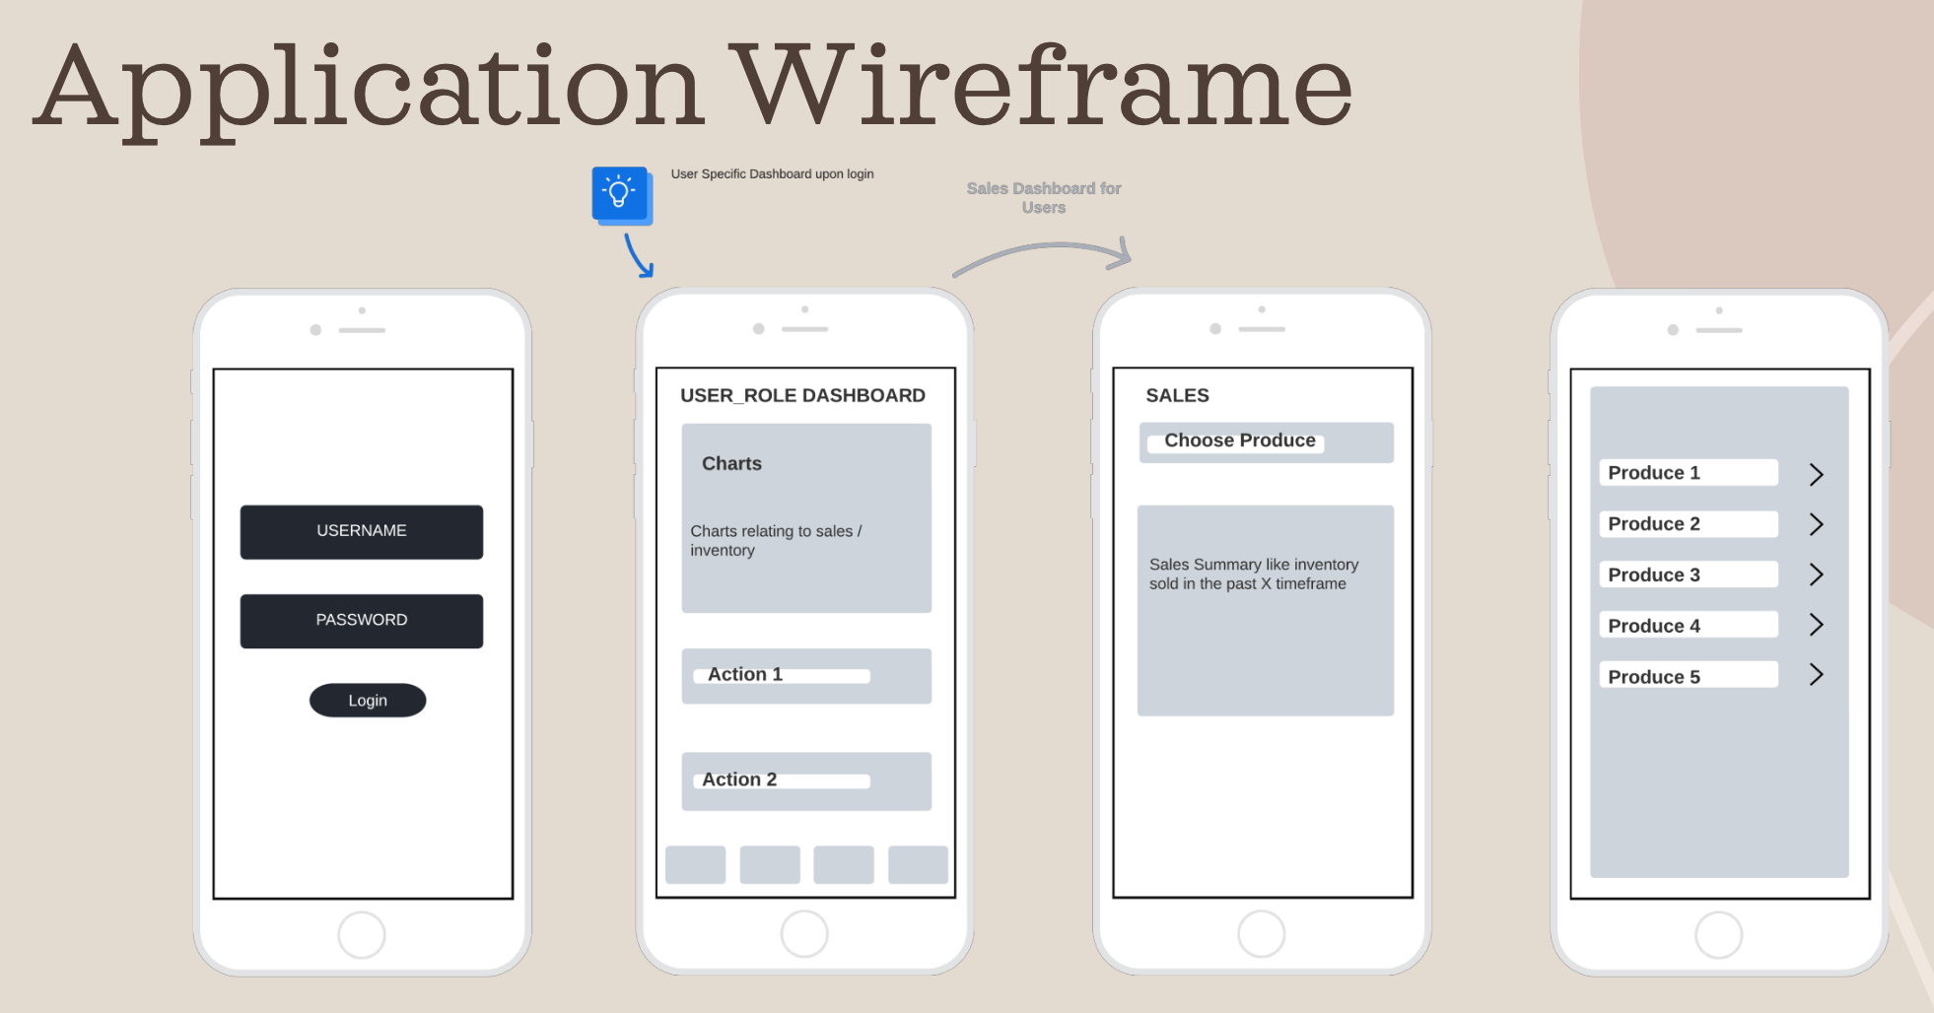
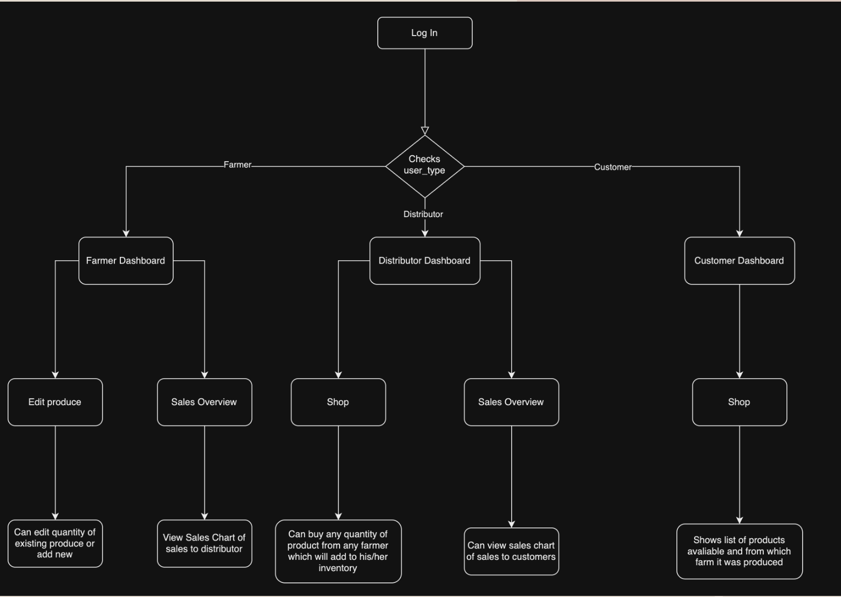
Farm 2 Fork
Data Administration Concepts and Database Management
(IST 659)
Project Summary:
A Powerapps application for inventory management and tracking system. This application increases supply chain transparency by allowing consumers to track product origins and businesses to efficiently manage transactions.
Demonstrated Learning Objectives:
Python and PowerApps were used to collect, store, and access data
Actionable Insights provided for farmers and consumers through data visualizations of their inventories and transactions
Ethical considerations of data accessibility and data transparency
Projects
Objective:
Increase food supply chain transparency
Bryce Anthony
Applied Data Science Portfolio Overview
December 2024

Slide 10
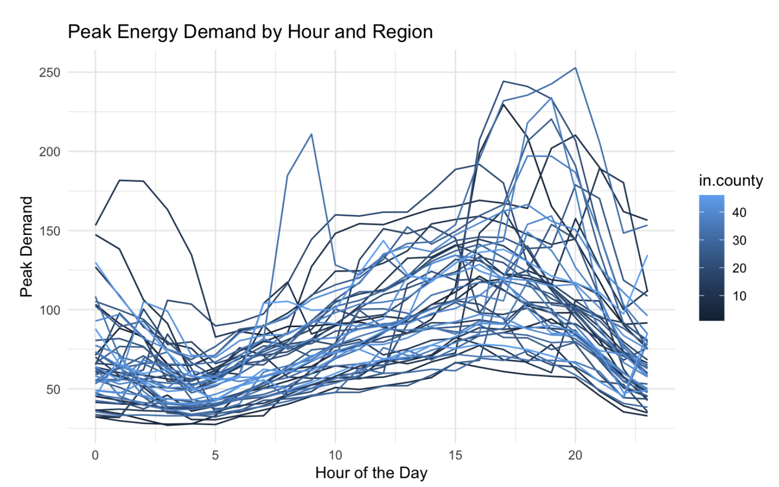
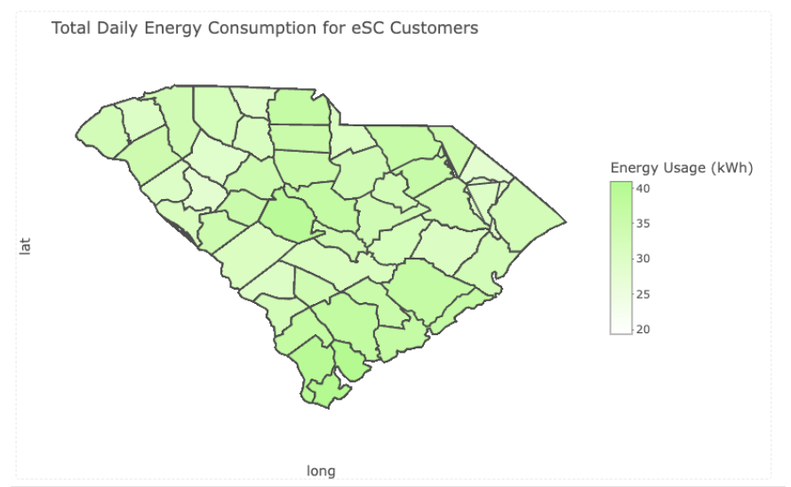
Energy Consumption Analysis
Introduction to Data Science
(IST 687)
Project Summary:
A project for a power company in the Carolinas, to address the impact of rising temperatures on its electrical grid. The goal of the project was to make data driven recommendations for the company to curtail future energy use by identifying the key factors influencing their customers energy consumption.
Demonstrated Learning Objectives:
Use of R and data visualizations to create actionable insights
Use of predictive modeling to create actionable insights
Communication of insights to technical and non-technical audiences using a shiny dashboard
Projects
Objective: Identify the key factors influencing energy consumption to curtail future energy demand
Bryce Anthony
Applied Data Science Portfolio Overview
December 2024

Slide 11
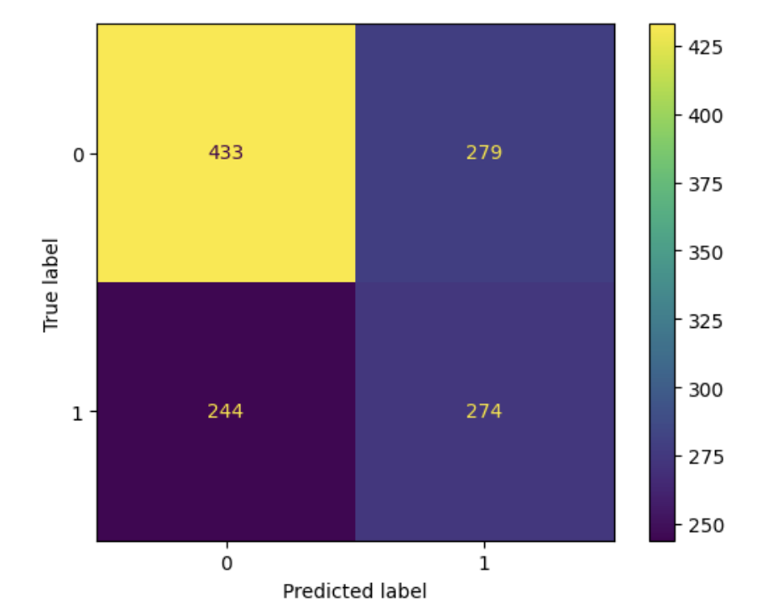
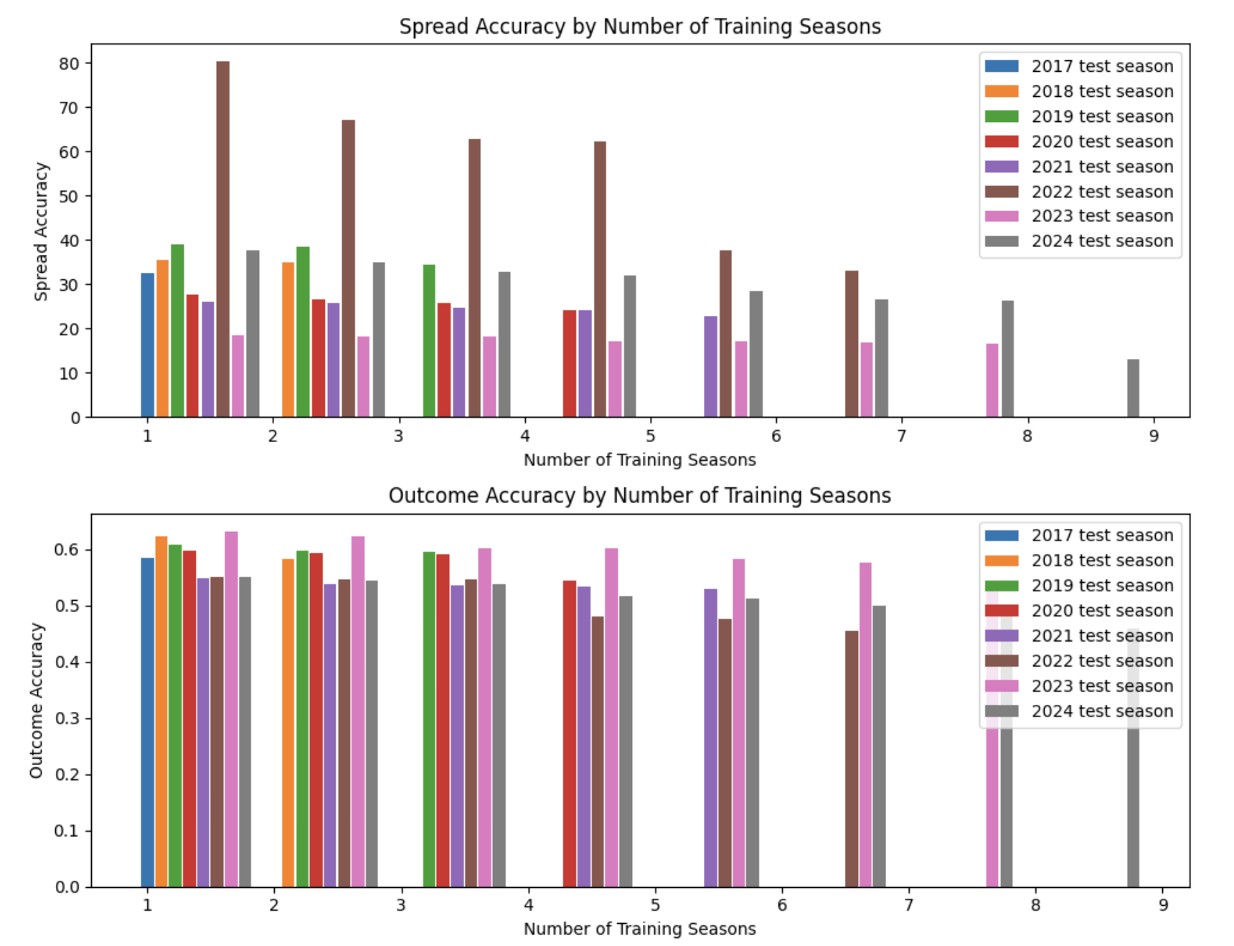
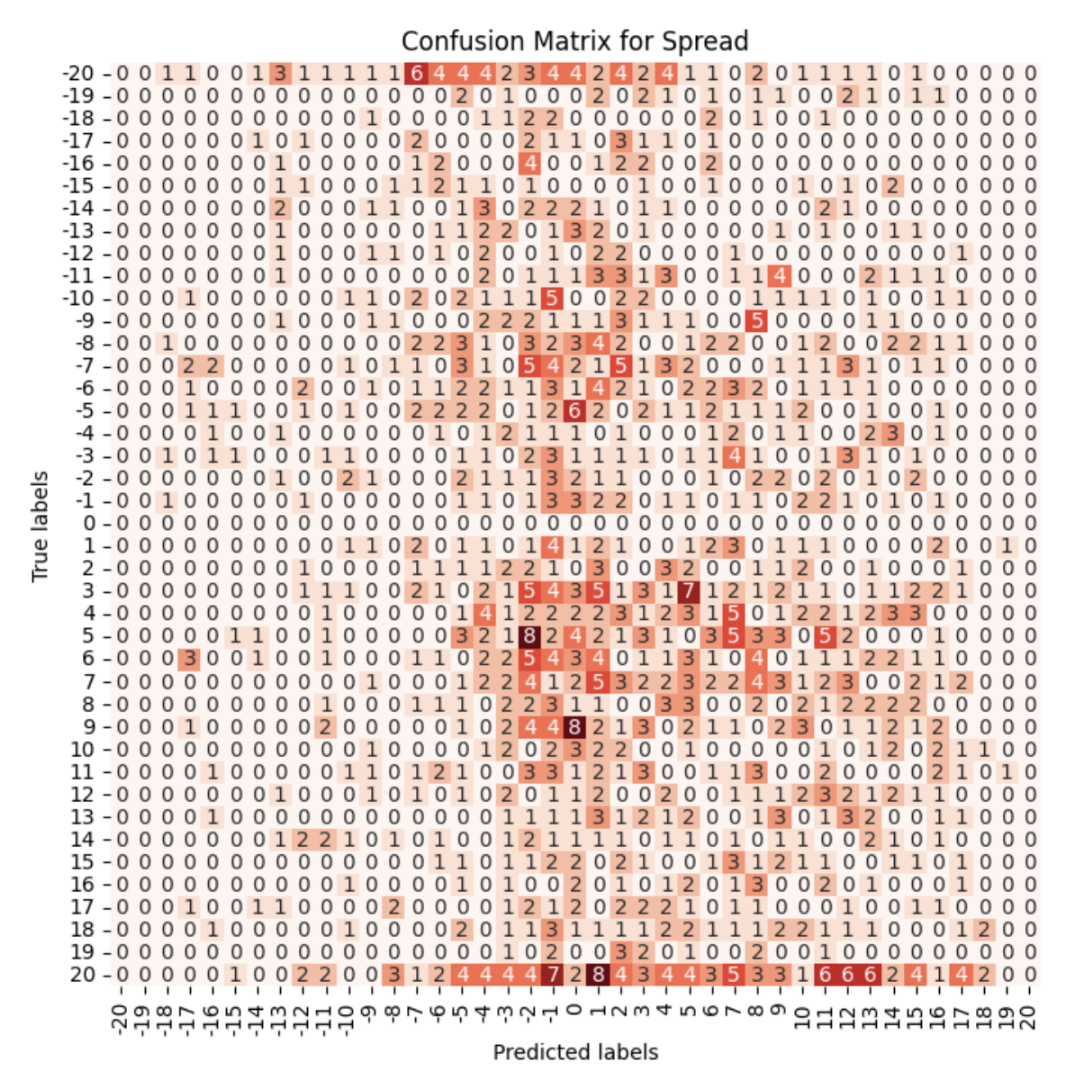
NBA Spread Prediction
Applied Machine Learning
(IST 707)
Project Summary:
A project providing AI-backed insights into the outcomes of NBA sporting events, enabling users—whether enthusiasts, analysts, pundits, or casual observers—to better understand individual games and their implications for the season. By giving users access to the predictive power of machine learning, the goal was to empower them to make more confident predictions and analyses.
Demonstrated Learning Objectives:
Python programming language used to Data collected via web scraping, stored in csv format using the pandas, and accessed for model predictions.
Developed a predictive deep learning model creating actionable insights by predicting the winner and point spread of NBA games.
Created visualizations to communicate model results and shortcomings to technical and non-technical stakeholders
Ethical considerations made for visualizations and communication of results
Projects
Objective: Provide AI-backed insights into the outcomes of NBA sporting events
Bryce Anthony
Applied Data Science Portfolio Overview
December 2024

Slide 12
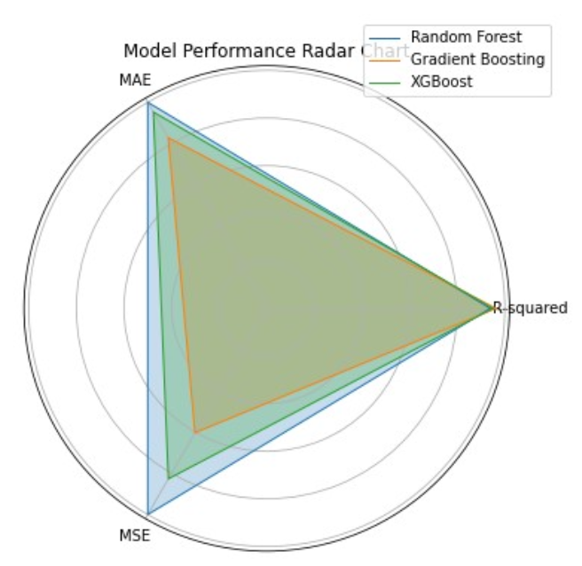
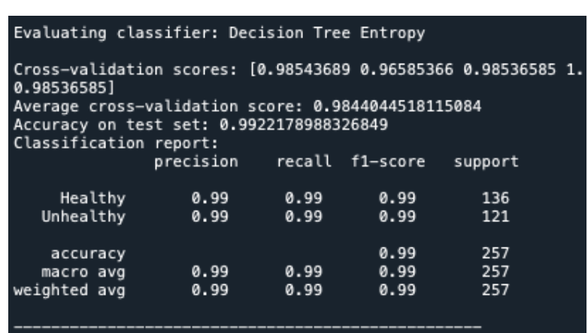
Healthiness Evaluation of Recipes
Text Mining
(IST 736)
Project Overview:
Developed a Machine learning model to evaluate the healthiness of recipes to empower individuals and businesses to make informed dietary choices. By leveraging ingredient names and key nutritional metrics, the tool aims to promote healthier eating habits and support the health and wellness goals of its users.
Demonstrated Learning Objectives:
The spoonacular API was used to collect data, the pandas library was used to store and access data.
Used a predictive model, developed in python, to generate actionable insights by labeling recipes as healthy or unhealthy
Balanced technical depth with accessibility by providing intuitive visualizations for various audiences
Projects
Objective: Develop a tool that accurately evaluates the healthiness of recipes
Bryce Anthony
Applied Data Science Portfolio Overview
December 2024

Slide 13

Book Emporium Sales Analysis
Business Analytics (SCM 651)
Project Overview:
For this assignment, I analyzed fictional sales data from the Book Emporium to help determine the optimal pricing strategy a Harry Potter sequel. The dataset provided included weekly sales figures and customer purchase percentages for the book. My goal was to identify a demand curve for the book, examining how changes in pricing affected customer purchases and use that info to recommend an optimal sale price for a sequel book that would maximize profits.
Demonstrated Learning Outcomes:
Analyzed fictional sales data using historical pricing and sales trends to make pricing, profit, and sales related insights for the new book.
Presented predictive model results clearly through visualizations to ensure stakeholder understanding and actionable takeaways.
Ethically set pricing by considering business goals with customer desires.
Projects
Objective: Determine the optimal pricing strategy for a Harry Potter sequel
Bryce Anthony
Applied Data Science Portfolio Overview
December 2024

Slide 14
04
CONCLUSION
Bryce Anthony
Applied Data Science Portfolio Overview
December 2024

Slide 15
Achievements Across Learning Objectives:
Demonstrated the ability to do data collection, modeling, visualization, and deployment using Python, R, and cloud technologies
Created actionable insights across a range of context (e.g. business, health, sports, and societal challenges)
Demonstrated ethical and responsible use of data science methodologies
Communicated findings effectively through visualizations and dashboards
Bryce Anthony
Applied Data Science Portfolio Overview
December 2024

Slide 16
Key Takeaways: Through the Applied Data Science program at Syracuse University, I have:
Mastered Applied Data Science Techniques:
Gained hands-on experience with data collection, preprocessing, modeling, and analysis.
Solved Real-World Challenges Across Domains:
Addressed business, societal, and environmental problems using data-driven solutions.
Enhanced Expertise in Data Science Methodologies and Machine Learning:
Developed, fine-tuned, and deployed predictive models to generate actionable insights.
Learned to Tackle Complex and Diverse Problems:
Applied the full data science life cycle to uncover solutions in areas like energy, health, sports, and business.
Refined the Ability to Effectively Apply Data Science:
Learned to strategically leverage tools, techniques, and ethical considerations to deliver impactful outcomes.
Bryce Anthony
Applied Data Science Portfolio Overview
December 2024

Slide 17
Thank you
Bryce Anthony
Applied Data Science Portfolio Overview
December 2024

